Slide 1
Analysis of Stress using Realtime Face, Speech and Emotion Recognition Under the Esteemed guidance of Dr. D. Manendra Sai Professor of Computer Science and Engineering Batch No:C14 T. Udaya Sree(20NM1A05H5) V. Vineela(20NM1A05H9) Pooja Mahapatro(20NM1A05E6) N. Sai Indrani(21NM5A0510) Sk. Sayyad Beebi(21NM5A0516)

Slide 2
CONTENTS
Abstract
Introduction
Literature Survey
Existing System
Problem Identification
Proposed System
Components Required
Architecture
Methodology
Output Screens
Future Scope

Slide 3
ABSTRACT
Face detection has been in existence for a considerable time. Looking ahead, there's a growing interest in conveying human emotions visually, either through recorded video or live streams. Understanding and interpreting human emotions from facial expressions is crucial for contemporary artificial intelligence systems. This capability enables these systems to mimic and evaluate emotions, aiding in tasks like marketing and security.While humans can easily recognize emotions from photos or videos, robots face challenges in doing so and require complex image processing algorithms for feature extraction. This process involves training algorithms on relevant datasets and then testing them for emotion detection and identification using machine learning techniques. This delves into various machine learning algorithms and feature extraction methods to facilitate accurate human emotion identification from images, thereby improving information extraction. Facial expressions serve as a vital nonverbal form of communication, encompassing eight universal emotions: neutral, happiness, sadness, anger, contempt, disgust, fear, and surprise. We propose a technology-driven monitoring system for the elderly that utilizes video analysis to detect emotions. This system gathers data from video feeds, enabling real-time monitoring of seniors' living conditions.

Slide 4
INTRODUCTION
One of the fastest and natural methods of communication between humans is a speech signal. For interaction between human and machine use of speech signal is the fastest and most efficient method utmost awareness of the message received, using every sense that a human is naturally capable of using. While emotional recognition is an extremely hard assignment for machines, it comes naturally to people. Based on this, an emotion detection system makes use of emotion-related knowledge to enhance machine-human communication.
Human existence is inextricably linked to emotions. There are several ways that we define emotions. They can be mistaken for sentiments or moods, and are commonly described as a complicated sequence of responses. They are the means by which people deal with issues or circumstances that hold personal significance for them. Another way to define emotion is as a conscious mental reaction (such fear or rage) that is subjectively seen as a powerful feeling, often aimed at a particular object. There are several ways to transmit emotions. One of the difficulties in the subject of human-machine interaction is getting a computer to understand the emotions a human is trying to express through a text or speech.

Slide 5
LITERATURE SURVEY
S. No. | Author(s) | Year | Methodology | Outcomes
1 | Chen, X. et al. | 2023 | Dual Adversarial Guided Unsupervised Multidomain Adaptation Network | Collaborative fault diagnosis of rotating machinery
2 | Li, X. et al. | 2023 | End-to-End Framework for Joint Denoising and Classification of Hyperspectral Images | Denoising and classification of hyperspectral images
3 | Yang, J. et al. | 2023 | Unsupervised Deep Tensor Network for Hyperspectral–Multispectral Image Fusion | Fusion of hyperspectral and multispectral images
4 | Huang, C. et al. | 2023 | Adaptive Cylinder Vector Particle Swarm Optimization with Differential Evolution | UAV path planning
5 | Zeng, H. et al. | 2022 | Multimodal Core Tensor Factorization and Its Applications to Low-Rank Tensor Completion | Low-rank tensor completion

Slide 6
EXISTING SYSTEM
In the realm of human emotion detection using machine learning techniques, existing systems have primarily relied on traditional methodologies such as manual feature extraction and classical machine learning models. These systems often utilize hand-crafted features such as facial landmarks, facial action units, and geometric attributes to classify emotions. While these features can provide insights into emotional expressions, they require significant domain expertise to create and may not capture the full complexity of human emotions. Additionally, traditional machine learning models like Support Vector Machines (SVM) and k-Nearest Neighbors (kNN) have been employed to classify emotions based on these features, but they often 6 struggle with the generalization required for diverse and real-world scenarios. Existing systems may also face limitations in terms of the range of emotions they can detect, often focusing on a narrow set of classes such as happy, sad, anger, and surprise. Furthermore, many earlier systems are constrained to offline processing, making them less suitable for real-time applications.

Slide 7
DISADVANTAGES OF THE EXISTING SYSTEM
Limited Accuracy: Existing projects often rely on traditional algorithms or simple machine learning models, which may struggle with accurately recognizing complex or nuanced emotions.
Narrow Emotion Range: These systems typically focus on primary emotions such as happiness, sadness, anger, and surprise, and may not effectively identify subtle emotional states.
Inconsistent Performance: Existing projects can be sensitive to variations in lighting, facial occlusions, and head pose, leading to inconsistent performance.
Lack of Real-Time Processing: Older systems may struggle to process video streams in real-time, resulting in lower frame rates and delays.
Limited User Experience: User interfaces in existing systems are often static, providing limited feedback and interactivity to users.

Slide 8
PROBLEM IDENTIFICATION
In the beginning, facial expression analysis was essentially a research topic for psychologists. However, recent progresses in image processing and pattern recognition have motivated significantly research works on automatic facial expression recognition. In the past, a lot of effort was dedicated to recognize facial expression in still images. The automatic facial expression recognition system includes:
Face Detector.
Facial feature extractor for mouth, left and right eye. Facial Characteristic Point - FCP extractor.
Facial expression recognizer

Slide 9
PROPOSED SYSTEM
The proposed system for human emotion detection employs advanced technologies such as deep learning models (e.g., convolutional neural networks) and state-of-the-art image processing techniques (e.g., OpenCV). These modern approaches enable the system to achieve higher accuracy in detecting a wide range of emotions, including more nuanced emotional states.
By leveraging transfer learning and pre-trained models, the proposed system efficiently handles real-time video streams and can generalize well across diverse demographics and environments. The system uses sophisticated feature extraction methods to precisely identify facial landmarks and action units.
Additionally, the proposed system includes an interactive and dynamic user interface that provides immediate feedback and visualizations of detected emotions.
Overall, the proposed system represents a significant advancement in terms of technology, performance, and user experience.

Slide 10
ADVANTAGES OF THE PROPOSED SYSTEM
Advanced Machine Learning Models: The proposed system utilizes state-of-the-art deep learning models such as convolutional neural networks (CNNs), leading to improved accuracy and generalization.
Broader Emotion Range: By using advanced models and diverse datasets, the proposed system can recognize a wider range of emotions, including complex and subtle states.
Real-Time Video Analysis: The proposed system efficiently handles real-time video streams, offering smooth, high-frame-rate processing for real-time emotion detection.
Robust Image Processing: Advanced image processing techniques, such as those provided by OpenCV, ensure precise facial detection and feature extraction even in challenging conditions.
Interactive User Interface: The proposed system includes a dynamic, user-friendly interface that provides immediate feedback and visualizations of detected emotions.
Scalability and Adaptability: The proposed system is designed to be scalable and adaptable, making it suitable for various applications across different industries such as healthcare, security, and human-computer interaction.

Slide 11
EXISTING AND PROPOSED MODEL
EXISTING MODEL | PROPOSED MODEL
The existing methods of stress analysis include paper method (self report),body fluid testing and physiological parameter evaluation. | In the proposed algorithm, face image and facial landmark detection with speech emotion detection is performed first for stress recognition.
Paper method is performed by providing a multiple choice questionnaire and asking the subjects to answer it, where each choice will have a particular score. | We use a Deep Neural Network(DNN) algorithm
Body fluid testing such as saliva testing or blood testing is done for the detection of stress hormone, cortisol. | The Results of stress recognition are composed of three classes: no stress, weak stress, and strong stress.

Slide 12
COMPONENTS REQUIRED
HARDWARE REQUIREMENTS:
System :intel i3/i5 2.4 ghz
Hard Disk : 500GB
Ram :4/8 GB
SOFTWARE REQUIREMENTS:
Operating system : Windows
Software Tool : Open CV Python
Coding Language : Python, Html, Java Script
Toolbox : Image processing toolbox
Librosa Audio Library

Slide 13
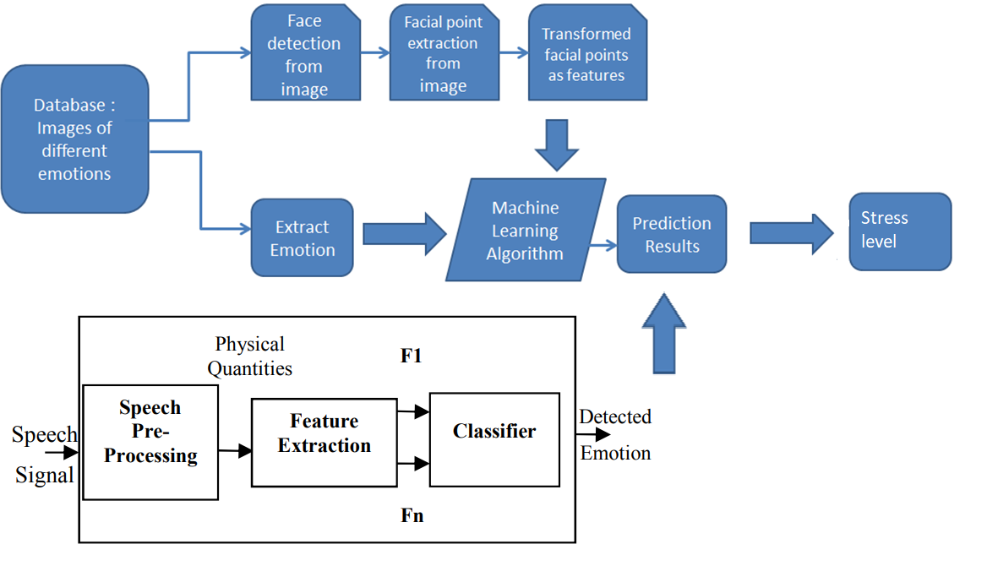
ARCHITECTURE

Slide 14
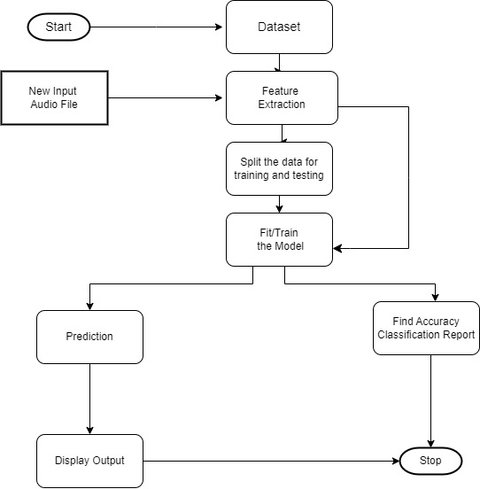
FLOW CHART

Slide 15
METHODOLOGY
Step 1: Face Registration
A computer technique called Face Registration is used in many different applications to recognize faces in digital photos. Using a series of landmark points known as ”face localization,” faces are initially found in the picture in this face registration process. ”Face detection.”
Step 2: Extraction of Facial Features
The technique of identifying particular areas, points, landmarks, curves, or contours in a given 2-D picture or 3D range image is known as facial features extraction, and it is a crucial stage in the face recognition process. The resultant registered picture is used to create a numerical feature vector in this feature extraction stage. Common traits that can be extracted region.
Step 3: Digital Image Processing
The spectrum of computerized picture preparation is exemplified by the need for extensive testing to increase the viability of suggested solutions for a particular problem. A crucial characteristic of the process of creating picture preparation frameworks is the extensive amount of testing and experimenting that is usually necessary before arriving at a workable solution.

Slide 16
Step 4: Flattening The next move is to flatten the pooled diagram of functions . Flattening means that the entire matrix of the pulled-up map is transformed into the neural network in a single column. Step 5: Full connection The flattened feature map should be moved through the neural network after flattening. This transfer is made via the plate, the completely attached plate, and the output sheet. The completely connected layer is similar to the hidden DNN layer but is in this case connected. Groups are supported by the output sheet. Knowledge is sent over the network and it calculates a prediction error. The failure is spread back through the network to improve the prediction. Usually, the last numbers the neural network produces are not even one. Yet these estimates must be reduced to zero to one, reflecting each class's probability. This is the role SoftMax plays.

Slide 17
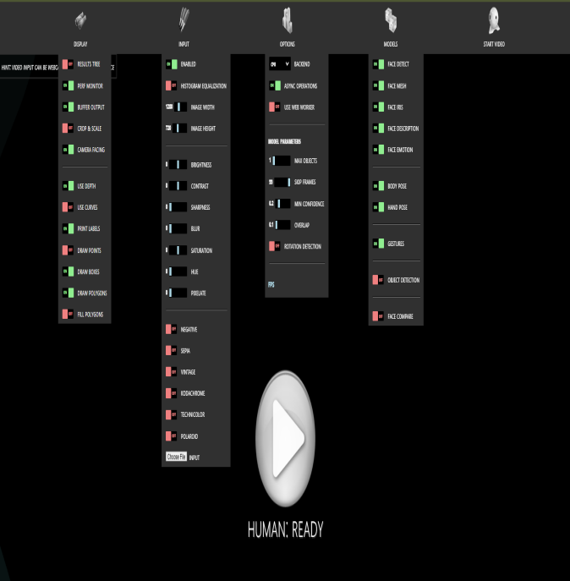

OUTPUT SCREENS

Slide 18
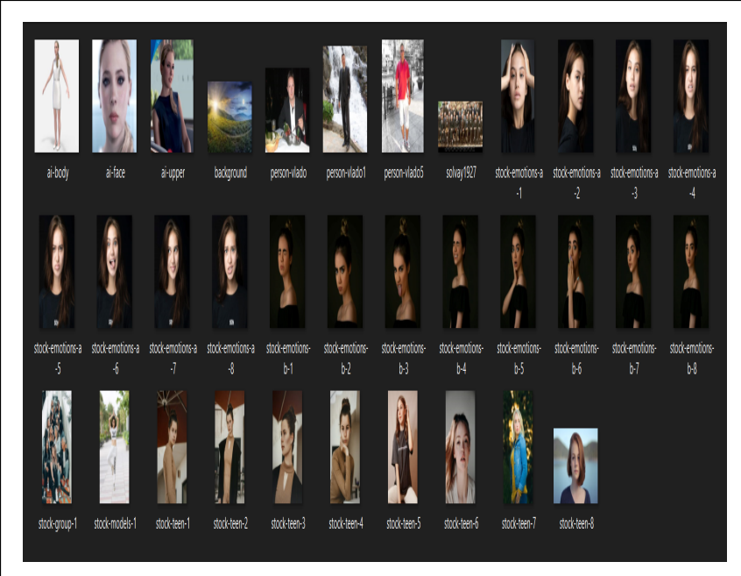
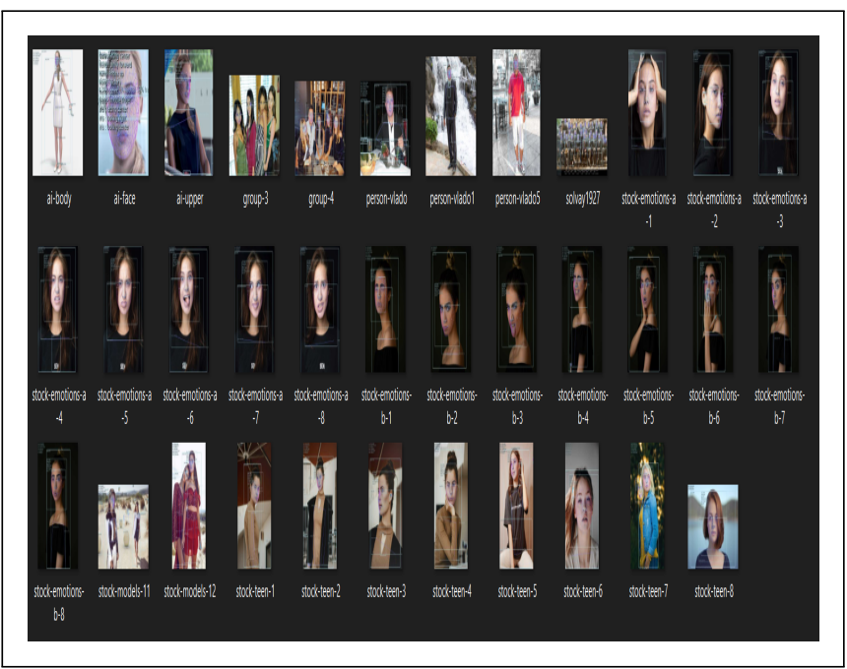
OUTPUT SCREENS

Slide 19

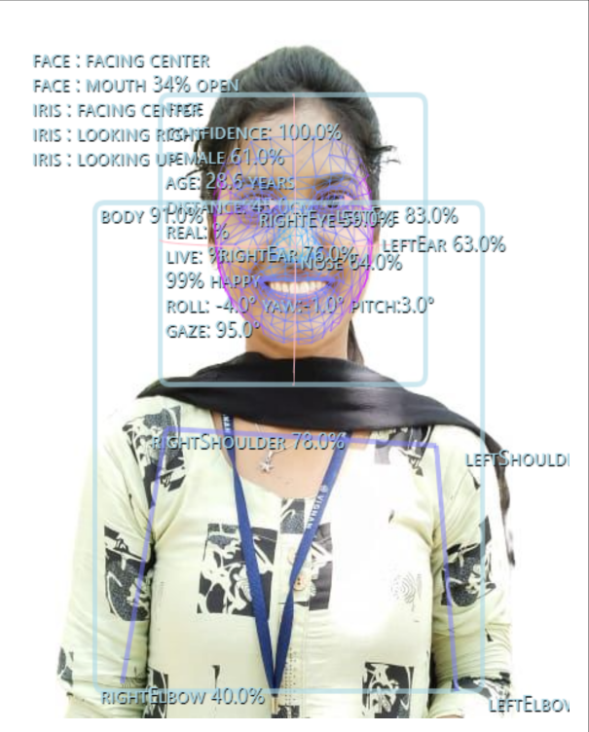

Slide 20
CONCLUSION
The purpose and objective of the project are achieved. By providing an extremely rich graphical user interface, web page designing is easy and in an aesthetic form. The human emotion detection system using advanced machine learning and image processing techniques presents a significant improvement over traditional approaches. By leveraging state-of-the-art models such as convolutional neural networks (CNNs) and efficient image processing methods like OpenCV, the proposed system achieves higher accuracy in recognizing a broader range of emotions, including complex and nuanced emotional states. Real-time video stream analysis and dynamic user interfaces enhance the system’s practical applications in fields such as healthcare, security, and human-computer interaction. The system’s robust performance demonstrates the potential for artificial intelligence to provide meaningful insights and improve user experiences through accurate emotion recognition. Nevertheless, there remain opportunities for further refinement, such as expanding the dataset to include more diverse and representative samples, optimizing models for specific use cases, and incorporating multimodal data sources like audio and contextual information.

Slide 21
FUTURE SCOPE
URLs and Online Datasets: Integrating the ability to retrieve and analyze images and videos directly from URLs can provide the system with access to a wider range of data from different sources, such as online databases, social media, and other web-based platforms.
College and Research Institution Datasets: Utilizing datasets from academic and research institutions can introduce greater variability and diversity in facial expressions and emotional states. These datasets often include a mix of controlled and naturalistic environments, providing a richer training ground for the model.
Crowdsourced Data: Collaborating with online communities and crowdsourcing platforms to gather data can further expand the dataset’s diversity, offering a broader representation of different demographics, ethnicities, and age groups.

Slide 22
THANK YOU

